Slide 1
Aktuelle Therapieempfehlungen beim Multiplen Myelom
Medizinische
Universität Wien
Heinz Gisslinger
Medizinische Universität Wien

Slide 2
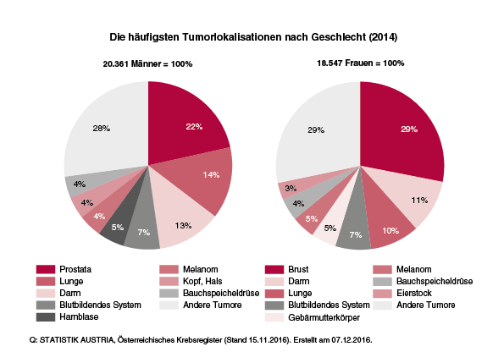
Das Multiple Myelom: eine heterogene Erkrankung mit hohem Anspruch an die Therapie¹
Die häufigsten Tumorlokalisationen nach Geschlecht (2014)
20.361 Männer = 100% 18.547 Frauen = 100%
Multiples Myelom:
Ca. 10% aller hämatologischen Malignitäten²
Inzidenz von 4 pro 100.000 (altersbereinigt)²
Statistik Austria (7.12.2016), http://www.statistik.at/web_de/statistiken/menschen_und_gesellschaft/gesundheit/krebserkrankungen/krebs_im_ueberblick/index.html (abgerufen am 12.4.2017)
1 Abdi J et al. Drug resistance in multiple myeloma: latest findings and new concepts on molecular mechanisms. Oncotarget 2013;4:2186-2207
2 Mahindra A et al. Latest advances and current challenges in the treatment of multiple myeloma. Nat Rev Clin Oncol 2012;9:135–143; published online 21 February 2012; doi:10.1038/nrclinonc.2012.15.

Slide 3
Verbesserung der Behandlungsmöglichkeiten des Multiplen Myeloms
EMA Zulassungsdatum
Bortezomib
Lenalidomid
Thalidomid
Pomalidomid
Lenalidomid
Panobinostat
Carfilzomib
Elotuzumab
Daratumumab
Ixazomib
Lenalidomid
Daratumumab
4/2004 (Zweitlinie)
6/2007 (Zweitlinie)
4/2008 (Erstlinie)
8/2013 (Drittlinie)
2/2015 (Erstlinie)
9/2015 (Drittlinie)
11/2015 (Zweitlinie)
3/2016 (Zweitlinie)
5/2016 (Monotherapie)
7/2016 (Zweitlinie)
2017 (Erhaltungstherapie)
9/2017 (Kombinationstherapie)
Zeit

Slide 4
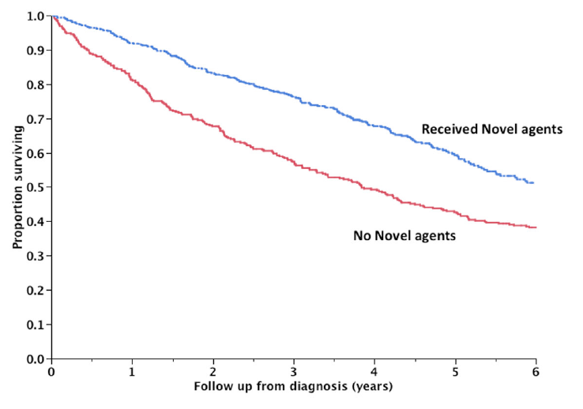
Overall survival of patients with MM has improved significantly with the approval of novel agents
Overall survival of NDMM pts receiving
novel agents vs no novel agents
 | Median OS
Novel agents | NR
No novel agents | 3.8 yrs
The use of novel agents
significantly increases the overall
survival of pts with NDMM (P<0.001).

Slide 5
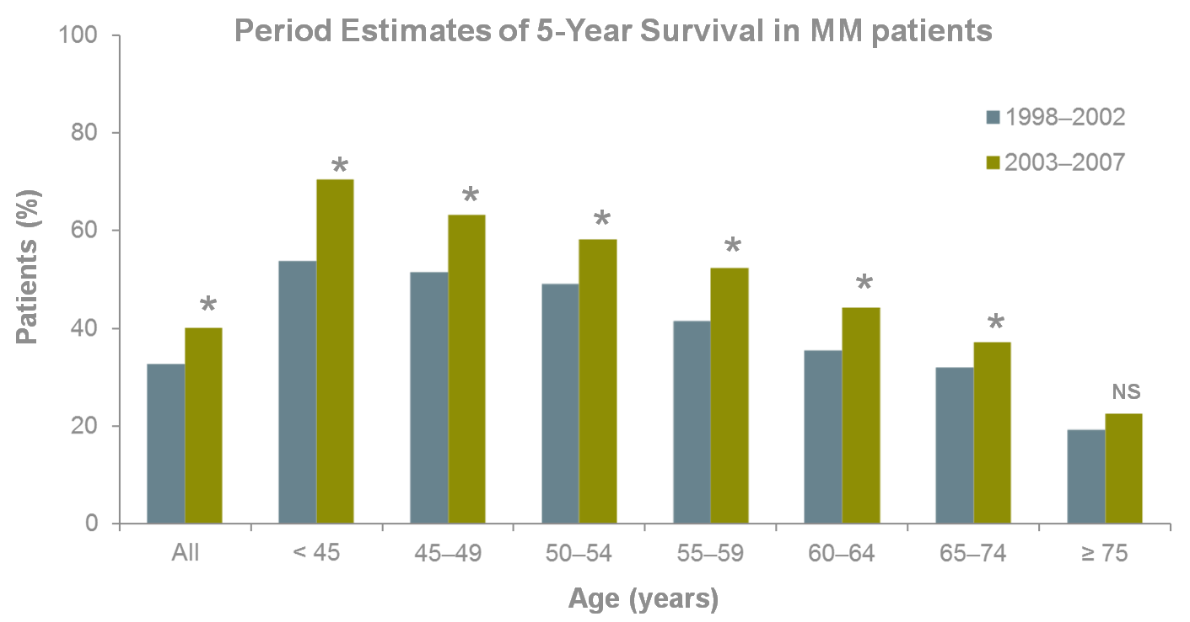
Novel Agents Improve OS Across Most Age Groups
All patient groups demonstrated improved OS except the very elderly (≥ 75 years)
Period Estimates of 5-Year Survival in MM patients
* p < 0.05.
MM, multiple myeloma; NS, not significant; OS, overall survival.
Pulte D, et al. Oncologist. 2011;16:1600-03.

Slide 6
Front-line treatment of symptomatic multiple myeloma outside clinical trials
Eligibility for autologous stem cell transplantation (ASCT)
Yes
No
Induction:
3 drug regimens
VTD
VCD
PAD
RVD
First option:
VMP or Rd or VRd
Second option:
MPT or VCD
Other options:
CTD, MP, bendamustine
prednisone
200 mg/m² melphalan followed by ASCT
Lenalidomide maintenance
CTD, cyclophosphamide, thalidomide, dexamethasone; MP, melphalan, prednisone; MPT, melphalan, prednisone, thalidomide; PAD, bortezomib, doxorubicin, dexamethasone; Rd, lenalidomide, low-dose dexamethasone; RVD, lenalidomide, bortezomib, dexamethasone; VCD, bortezomib, cyclophosphamide, dexamethasone; VMP, bortezomib, melphalan, prednisone; VRd, lenalidomide, low-dose dexamethasone, bortezomib; VTD, bortezomib, thalidomide, dexamethasone
Moreau et al, Annals Onco 2017

Slide 7
Überblick zugelassener Therapien beim Multiplen Myelom*^{,1-8}
*Stand Juni 2017 – Kein Anspruch auf Vollständigkeit. Bitte beachten Sie die vollständigen Anwendungsgebiete der Arzneimittel in der jeweiligen Fachinformation
D = DARZALEX® (Daratumumab)
d = Dexamethason
E = Empliciti® (Elotuzumab)
I = Ninlaro® (Ixazomib)
K = Kyprolis® (Carfilzomib)
M = Melphalan
P = Prednison
PLd = CAELYX® (peg. liposomales Doxorubicin)
Pano = Farydak® (Panobinostat)
Pom = IMNOVID® (Pomalidomid)
R = Revlimid® (Lenalidomid)
T = Thalidomid
V = VELCADE® (Bortezomib)
1 Fachinformation Velcade 21.2.2017, 2 Fachinformation Darzalex 2.8.2017, 3 Fachinformation Revlimid (April 2017) unter: http://www.ema.europa.eu/ (aufgerufen am 23.5.2017), 4 Fachinformation Kyprolis (April 2017) unter: http://www.ema.europa.eu/ (aufgerufen am 23.5.2017), 5 Fachinformation Farydak (Nov 2016) unter: http://www.ema.europa.eu/ (aufgerufen am 23.5.2017), 6 Fachinformation Imnovid (Sep 2016) unter: http://www.ema.europa.eu/ (aufgerufen am 23.5.2017), 7 Fachinformation Empliciti (Dez 2016) unter: http://www.ema.europa.eu/ (aufgerufen am 23.5.2017), 8 Fachinformation Ninlaro (Dez 2016) unter: http://www.ema.europa.eu/ (aufgerufen am 23.5.2017)

Slide 8
First-line treatment of young patients
Transplant is required
The goal of transplant is to achieve the lowest residual disease (RD)
Consolidation post-transplant decreases this RD
However, RD is almost always present after transplant + consolidation and is responsible for relapse (no plateau on PFS curve)
Thus, maintenance was a logical solution to control this RD!

Slide 9
PFS in the IFM trials
IFM, Intergroupe Francophone du Myelome; PFS, progression-free survival; RVD, lenalidomide, bortezomib and dexamethasone.
Attal M, et al. N Engl J Med 1996;335:91–7; Attal M, et al. N Engl J Med 2017;376:1311–20.

Slide 10
First-line treatment of young patients
Transplant is required
The goal of transplant is to achieve the lowest residual disease (RD)
Consolidation post-transplant decreases this RD
However, RD is almost always present after transplant + consolidation and is responsible for relapse (no plateau on PFS curve)
Thus, maintenance was a logical solution to control this RD!

Slide 11
First-line treatment of young patients
Transplant is required
The goal of transplant is to achieve the lowest residual disease (RD)
Consolidation post-transplant decreases this RD
However, RD is almost always present after transplant + consolidation and is responsible for relapse (no plateau on PFS curve)
Thus, maintenance was a logical solution to control this RD!

Slide 12
IFM 2009 VGPR rate during each treatment phase
ASCT, autologous stem cell transplant; HDM, high-dose melphalan; IFM, Intergroupe Francophone du Myelome; MM, multiple myeloma; NS, non-significant; RVD, lenalidomide, bortezomib and dexamethasone;
VGPR, very good partial response.
Attal M, et al. N Engl J Med 2017;376:1311–20.

Slide 13
IFM 2009: PFS
IFM, Intergroupe Francophone du Myelome; PFS, progression-free survival; RVD, lenalidomide, bortezomib and dexamethasone.
Attal M, et al. N Engl J Med 2017;376:1311–20.

Slide 14
First-line treatment of young patients
Transplant is required
The goal of transplant is to achieve the lowest residual disease (RD)
Consolidation post-transplant decreases this RD
However, RD is almost always present after transplant + consolidation and is responsible for relapse (no plateau on PFS curve)
Thus, maintenance was a logical solution to control this RD!

Slide 15
Verbesserung der Behandlungsmöglichkeiten des Multiplen Myeloms
EMA Zulassungsdatum
Bortezomib
Lenalidomid
Thalidomid
Pomalidomid
Lenalidomid
Panobinostat
Carfilzomib
Elotuzumab
Daratumumab
Ixazomib
Lenalidomid
Daratumumab
4/2004 (Zweitlinie)
6/2007 (Zweitlinie)
4/2008 (Erstlinie)
8/2013 (Drittlinie)
2/2015 (Erstlinie)
9/2015 (Drittlinie)
11/2015 (Zweitlinie)
3/2016 (Zweitlinie)
5/2016 (Monotherapie)
7/2016 (Zweitlinie)
2/2017 (Erhaltungstherapie)
9/2017 (Kombinationstherapie)
Zeit

Slide 16
Studies included in meta-analysis
ªStarting dose of 10 mg/day on Days 1–28/28 was increased to 15 mg/day if tolerated and continued until PD. ^{b}Patients received 10 mg/day on Days 1–21/28 until PD.
ASCT, autologous stem cell transplant; DEX, dexamethasone; LEN, lenalidomide; MNTC, maintenance; MPR, melphalan, prednisone, and lenalidomide; NDMM, newly diagnosed multiple myeloma; PD, progressive disease.
McCarthy PL, Attal M, et al. Presented at IMW 2017 (abstract OP-010).

Slide 17
Meta-analysis: OS Data cut-off March 2015, median follow-up 80 months
CI, confidence interval; HR, hazard ratio; IFM, Intergroupe Francophone du Myelome; LEN, lenalidomide; Maint, maintenance; NE, not evaluable; OS, overall survival.
McCarthy PL, Attal M, et al. Presented at IMW 2017 (abstract OP-010).

Slide 18
OS: Subgroup analysis

Slide 19
LEN maintenance post-ASCT: Adverse events CALGB 100104 and IFM 2005-02 trials
DVT
CALGB: No DVT SAEs reported in either arm
IFM: 1% with LEN vs 0% with placebo
Peripheral sensory neuropathy
CALGB: Rate of Grade 3–4 peripheral neuropathy was 2.7% for both LEN and placebo arms
IFM: No Grade 3–4 peripheral neuropathy was reported in either arm
ªIn Study CALGB 100104, for placebo subjects, only AEs up to crossing over to lenalidomide are included; ^{b}Data were excluded from all subjects for the two cycles of lenalidomide consolidation (R 25 mg QD 21/28).
AE, adverse event; ASCT, autologous stem cell transplant; DVT, deep vein thrombosis; IFM, Intergroupe Francophone du Myelome; LEN, lenalidomide; PBO, placebo; QD, once daily; R, randomisation; SAE, serious adverse event; TEAE, treatment-emergent adverse event.
REVLIMID® EPAR 2017. Available at: www.ema.europe.eu. Last accessed June 2017.

Slide 20
SPMs following start of maintenance therapy Data cut-off 01 March 2015; pooled data from CALGB1004 and IFM2005
ªPatients who experienced more than one SPM (e.g., two types of SPMs) or more than one episode of an SPM are counted once in each SPM category. ^{b}In the GINEMA-RV-MM-PI-209 study, the no maintenance arm includes patients eligible for the maintenance phase without any dose of LEN maintenance.
AML, acute myeloid leukaemia; IFM, Intergroupe Francophone du Myelome; LEN, lenalidomide; MDS, myelodysplastic syndromes; SPM, second primary malignancy.
REVLIMID® EPAR 2017. Available at: www.ema.europe.eu. Last accessed June 2017.

Slide 21
Cumulative incidence for time to onset of SPMs Data cut-off 01 March 2015; pooled data from CALGB1004, IFM2005, GIMEMA RV209
ªHR based on Cox proportional hazards model. ^{b}p value is based on log-rank test.
CI, confidence interval; HR, hazard ratio; IFM, Intergroupe Francophone du Myelome; SPM, second primary malignancy.
Attal M, McCarthy PL, et al. Presented at ASCO 2016 (abstract 8001).

Slide 22
LEN maintenance post-ASCT: Time to death by cause of death (meta-analysis) Data cut-off March 2015; pooled data from CALGB1004, IFM2005, GIMEMA RV209
Median follow-up: 80 months.
ASCT, autologous stem cell transplant; IFM, Intergroupe Francophone du Myelome; LEN, lenalidomide; maint, maintenance; MM, multiple myeloma; SPM, second primary malignancy.
McCarthy PL, et al. Presented at IMW 2017 (abstract OP-010).

Slide 23
LEN maintenance after transplantation
LEN maintenance significantly prolonged PFS post-ASCT^{1,2}
LEN maintenance significantly prolonged OS post-ASCT³
HR 0.744 (95% CI: 0.62–0.89)
Log-rank p=0.001
Approximately 2.5-year improvement in median OS
The efficacy of LEN is considered clinically relevant and, in the view of the safety profile, the benefits are considered to outweigh the combined risks⁴
LEN is the only approved drug
Thus, LEN is ‘the standard of care’
ASCT, autologous stem cell transplant; CI, confidence interval; HR, hazard ratio; LEN, lenalidomide; OS, overall survival; PFS, progression-free survival.
1. Attal M, et al. N Engl J Med 2012;366:1782–91; 2. McCarthy PL, et al. N Engl J Med 2012;366:1770–81; 3. Attal M, McCarthy PL, et al. Presented at ASCO 2016 (abstract 8001); 4. REVLIMID® EPAR 2017. Available at: www.ema.europe.eu. Last accessed June 2017.

Slide 24
FIRST Trial: impact of response study design^{1,2}
Screening
Active Treatment + PFS Follow-Up Phase
LT Follow-Up
RANDOMIZATION 1:1:1
Arm A
Rd Continuous
LEN + LoDEX Continuously
LENALIDOMIDE 25 mg D1-21/28
LoDEX 40 mg D1, 8, 15, and 22/28
PD or Unacceptable Toxicity
PD, OS, and
Subsequent AMT
Arm B
Rd18
LEN + LoDEX 18 Cycles (72 wks) LENALIDOMIDE 25 mg D1-21/28
LoDEX 40 mg D1, 8, 15, and 22/28
MEL + PRED + THAL 12 Cycles (72 wks)
MELPHALAN 0.25 mg/kg D1-4/42
PREDNISONE 2 mg/kg D1-4/42
THALIDOMIDE 200 mg D1-42/42
Arm C
MPT
Pts aged > 75 yrs: LoDEX 20 mg D1, 8, 15, and 22/28; THAL 100 mg D1-42/42; MEL 0.2 mg/kg D1-4/42.
All pts received thromboprophylaxis.
Stratification: age, country, and ISS stage
As of March 3, 2014, median follow-up was 45.5 mos
AMT, antimyeloma therapy; ISS, International Staging System; LEN, lenalidomide; LoDEX, low-dose dexamethasone; LT, long-term; MEL, melphalan; MPT, melphalan, prednisone, and thalidomide; OS, overall survival; PD, progressive disease; PFS, progression-free survival; PRED, prednisone; pt, patient; Rd continuous, lenalidomide plus low-dose dexamethasone until disease progression; Rd18, lenalidomide and low-dose dexamethasone for 18 cycles; THAL, thalidomide.
1. Benboubker L, et al. N Engl J Med. 2014;371: 906-17. 2. Bahlis NJ, et al. Leukemia, 2017;31(11):2435–2442.

Slide 25
FIRST Trial: impact of response DOR by Response
Median DOR was prolonged with Rd continuous vs MPT and Rd18 across all response subgroups, especially in pts with deep responses
CR | Median (mos)
Rd cont | 59.1
Rd18 | 40.1
MPT | 34.2
100
≥ VGPR | Median (mos)
Rd cont | 49.0
Rd18 | 28.1
MPT | 28.8
Hazard Ratio (95% CI); P value
Rd cont vs MPT: 0.60 (0.51-0.72); P < .00001
Rd cont vs Rd18: 0.62 (0.52-0.73); P < .00001
100
100
80
80
80
60
60
60
Patients (%)
Patients, %
Patients, %
40
40
40
20
Hazard Ratio (95% CI); P value
Rd cont vs MPT: 0.31 (0.19-0.51); P < .00001
Rd cont vs Rd18: 0.38 (0.24-0.60); P = .00001
20
Hazard Ratio (95% CI); P value
Rd cont vs MPT: 0.47 (0.36-0.62); P < .00001
Rd cont vs Rd18: 0.46 (0.36-0.59); P < .00001
20
≥ PR | Median (mos)
Rd cont | 31.5
Rd18 | 21.5
MPT | 22.1
0
0
0
0
6
12
18
24
30
36
42
48
54
60
66
72
0
6
12
18
24
30
36
42
48
54
60
66
72
0
6
12
18
24
30
36
42
48
54
60
66
72
DOR (mos)
DOR (mos)
DOR (mos)
No. at Risk
Rd cont | 114 | 113 | 108 | 101 | 93 | 85 | 76 | 58 | 37 | 14 | 2 | 1 | 1
Rd18 | 110 | 107 | 100 | 94 | 84 | 69 | 53 | 29 | 16 | 5 | 2 | 0
MPT | 66 | 66 | 63 | 55 | 44 | 39 | 27 | 16 | 10 | 2 | 0
No. at Risk
Rd cont | 258 | 249 | 228 | 209 | 179 | 150 | 125 | 85 | 48 | 19 | 4 | 1 | 1
Rd18 | 255 | 236 | 213 | 179 | 130 | 102 | 72 | 37 | 21 | 6 | 2 | 0
MPT | 166 | 158 | 138 | 115 | 83 | 67 | 43 | 26 | 14 | 4 | 0
No. at Risk
Rd cont | 432 | 360 | 302 | 250 | 209 | 174 | 144 | 95 | 52 | 20 | 4 | 1 | 1
Rd18 | 425 | 362 | 306 | 225 | 152 | 110 | 77 | 38 | 22 | 6 | 2 | 0
MPT | 368 | 310 | 249 | 189 | 131 | 98 | 60 | 34 | 16 | 4 | 0
cont, continuous; CR, complete response; DOR, duration of response; MPT, melphalan, prednisone, and thalidomide; PR, partial response; pt, patient; Rd continuous, lenalidomide plus low-dose dexamethasone until disease progression; Rd18, lenalidomide and low-dose dexamethasone for 18 cycles; VGPR, very good partial response.
Reprinted from Bahlis NJ, et al. Leukemia, 2017;31(11):2435–2442. Creative Commons Attribution 4.0 International License (https://creativecommons.org/licenses/by/4.0/).

Slide 26
FIRST Trial: impact of response DOR in pts with ≥ vgpr: Subgroup analyses
Rd contª | MPTª | HR (95% CI)
84 | 58 | 0.55 (0.35-0.87)
174 | 108 | 0.44 (0.32-0.62)
111 | 79 | 0.42 (0.28-0.63)
147 | 87 | 0.52 (0.36-0.74)
160 | 91 | 0.48 (0.33-0.69)
98 | 75 | 0.51 (0.34-0.75)
127 | 80 | 0.54 (0.37-0.77)
131 | 86 | 0.41 (0.28-0.62)
84 | 46 | 0.33 (0.18-0.58)
122 | 89 | 0.58 (0.41-0.83)
51 | 29 | 0.50 (0.28-0.92)
225 | 125 | 0.47 (0.35-0.64)
32 | 40 | 0.66 (0.37-1.19)
13 | 5 | 0.78 (0.23-2.61)
101 | 80 | 0.43 (0.29-0.65)
Age
> 75 y
≤ 75 y
Sex
Female
Male
ISS stage
I/II
III
CrCl
< 60 mL/min
≥ 60 mL/min
0
ECOG PS
1
2
LDH
< 200 U/L
≥ 200 U/L
Cytogenetics
High risk
Not high risk
0.125
0.25
0.5
HR
1
2
4
Favors Rd cont
Favors MPT
ª Number of pts. CrCl, creatinine clearance; DOR, duration of response; ECOG PS, Eastern Cooperative Oncology Group performance status; HR, hazard ratio; ISS, International Staging System; LDH, lactate dehydrogenase; MPT, melphalan, prednisone, and thalidomide; Rd cont, lenalidomide plus low-dose dexamethasone until disease progression; VGPR, very good partial response.
Reprinted from Bahlis NJ, et al. Leukemia, 2017;31(11):2435–2442. Creative Commons Attribution 4.0 International License (https://creativecommons.org/licenses/by/4.0/).

Slide 27
FIRST Trial: impact of response PFS by response: CR and ≥ VGPR Subgroups
100
100
80
80
60
60
Survival Probability
CR | 4-Y PFS (%) | Median (mos)
Rd cont | 74.8 | 60.0
Rd18 | 39.8 | 41.0
MPT | 37.5 | 37.3
Survival Probability
40
40
≥ VGPR | 4-Y PFS (%) | Median (mos)
Rd cont | 54.7 | 50.9
Rd18 | 22.6 | 30.0
MPT | 23.0 | 31.8
20
Hazard ratio (95% CI); P value
Rd cont vs MPT: 0.33 (0.20-0.53); P < .00001
Rd cont vs Rd18: 0.39 (0.25-0.61); P = .00002
20
Hazard ratio (95% CI); P value
Rd cont vs MPT: 0.49 (0.38-0.64); P < .00001
Rd cont vs Rd18: 0.46 (0.36-0.59); P < .00001
0
0
0
6
12
18
24
30
36
42
48
54
60
66
72
0
6
12
18
24
30
36
42
48
54
60
66
72
Progression-Free Survival (mos)
Progression-Free Survival (mos)
No. at Risk
Rd cont | 114 | 113 | 109 | 104 | 97 | 86 | 80 | 65 | 42 | 15 | 1 | 0
Rd18 | 110 | 108 | 102 | 96 | 85 | 75 | 56 | 37 | 20 | 11 | 3 | 0
MPT | 66 | 66 | 64 | 59 | 49 | 41 | 32 | 21 | 11 | 6 | 0
No. at Risk
Rd cont | 258 | 253 | 234 | 216 | 189 | 157 | 138 | 100 | 59 | 24 | 5 | 0
Rd18 | 255 | 243 | 220 | 194 | 142 | 113 | 81 | 50 | 25 | 12 | 3 | 0
MPT | 166 | 161 | 145 | 130 | 99 | 73 | 52 | 35 | 16 | 9 | 0
CR, complete response; MPT, melphalan, prednisone, and thalidomide; PFS, progression-free survival; Rd cont, lenalidomide plus low-dose dexamethasone until disease progression; Rd18, lenalidomide and low-dose dexamethasone for 18 cycles; VGPR, very good partial response.
Reprinted from Bahlis NJ, et al. Leukemia, 2017;31(11):2435–2442. Creative Commons Attribution 4.0 International License (https://creativecommons.org/licenses/by/4.0/).

Slide 28
Verbesserung der Behandlungsmöglichkeiten des Multiplen Myeloms
EMA Zulassungsdatum
Bortezomib
Lenalidomid
Thalidomid
Pomalidomid
Lenalidomid
Panobinostat
Carfilzomib
Elotuzumab
Daratumumab
Ixazomib
Lenalidomid
Daratumumab
4/2004 (Zweitlinie)
6/2007 (Zweitlinie)
4/2008 (Erstlinie)
8/2013 (Drittlinie)
2/2015 (Erstlinie)
9/2015 (Drittlinie)
11/2015 (Zweitlinie)
3/2016 (Zweitlinie)
5/2016 (Monotherapie)
7/2016 (Zweitlinie)
2017 (Erhaltungstherapie)
9/2017 (Kombinationstherapie)
Zeit

Slide 29
Relapsed/refractory MM: ESMO guidelines 2017
First relapse after IMiD-based induction
First relapse after Bortezomib-based induction
Doublets
Kd / Vd
Triplets based on Bortezomib
DaraVD or PanoVD or
EloVD or VCD
Rd
Triplets based on Rd
DaraRd or KRd or IxaRd or EloRd
At second or subsequent relapse
Pomalidomide-Dex
(as a backbone)
+ Cyclo or Ixa or Bort or Dara or Elo
Daratumumab
(single agent or combination)
Clinical trial
Moreau P, et al. Ann Oncol 2017;00:1–11, 2017.

Slide 30
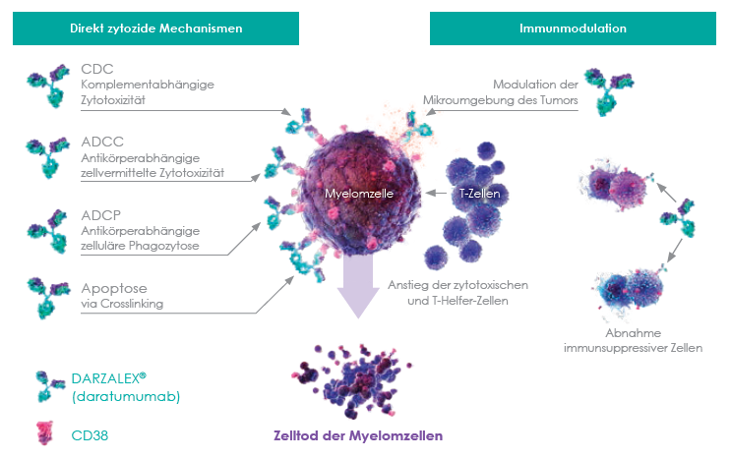
Daratumomab Wirkmechanismus der erste zugelassene humane IgG1κ monoklonale Antikörper zielgerichtet gegen CD38¹⁻³
Innovativer Wirkmechanismus:
Effektiv als Mono- und Kombinationstherapie¹⁻⁵
1 Krejcik J et al. ASH 2015; Orlando, FL. Abstract 3037; 2 Usmani S et al. Clinical Efficacy of Daratumumab Monotherapy in Patients With Heavily Pretreated Relapsed or Refractory Multiple Myeloma. Blood 2016; 128(1):37-44; 3 DARZALEX Fachinformation 2.8.2017; 4 Palumbo A. et al. Daratumumab, Bortezomib, and Dexamethasone for Multiple Myeloma. NEJM 2016; 375(8):754-766;
5 Dimopoulos MA. et al. Daratumumab, Lenalidomide, and Dexamethasone for Multiple Myeloma. NEJM 2016; 375(14):1319-1331

Slide 31
Daratumomab Indikation Zulassung als Mono- und Kombinationstherapie im Fortgeschrittenen MM¹
DVd
DRd
Daratumomab ist indiziert in Kombination mit Lenalidomid und Dexamethason oder Bortezomib und Dexamethason für die Behandlung erwachsener Patienten mit multiplem Myelom, die bereits mindestens eine Therapie erhalten haben.¹
Mono-therapie
Daratumomab ist indiziert als Monotherapie für die Behandlung erwachsener Patienten mit rezidiviertem und refraktärem multiplen Myelom, die bereits mit einem Proteasom-Inhibitor und einem Immun-modulator behandelt wurden und die während der letzten Therapie eine Krankheitsprogression zeigten.¹
1 DARZALEX Fachinformation 2.8. 2017

Slide 32
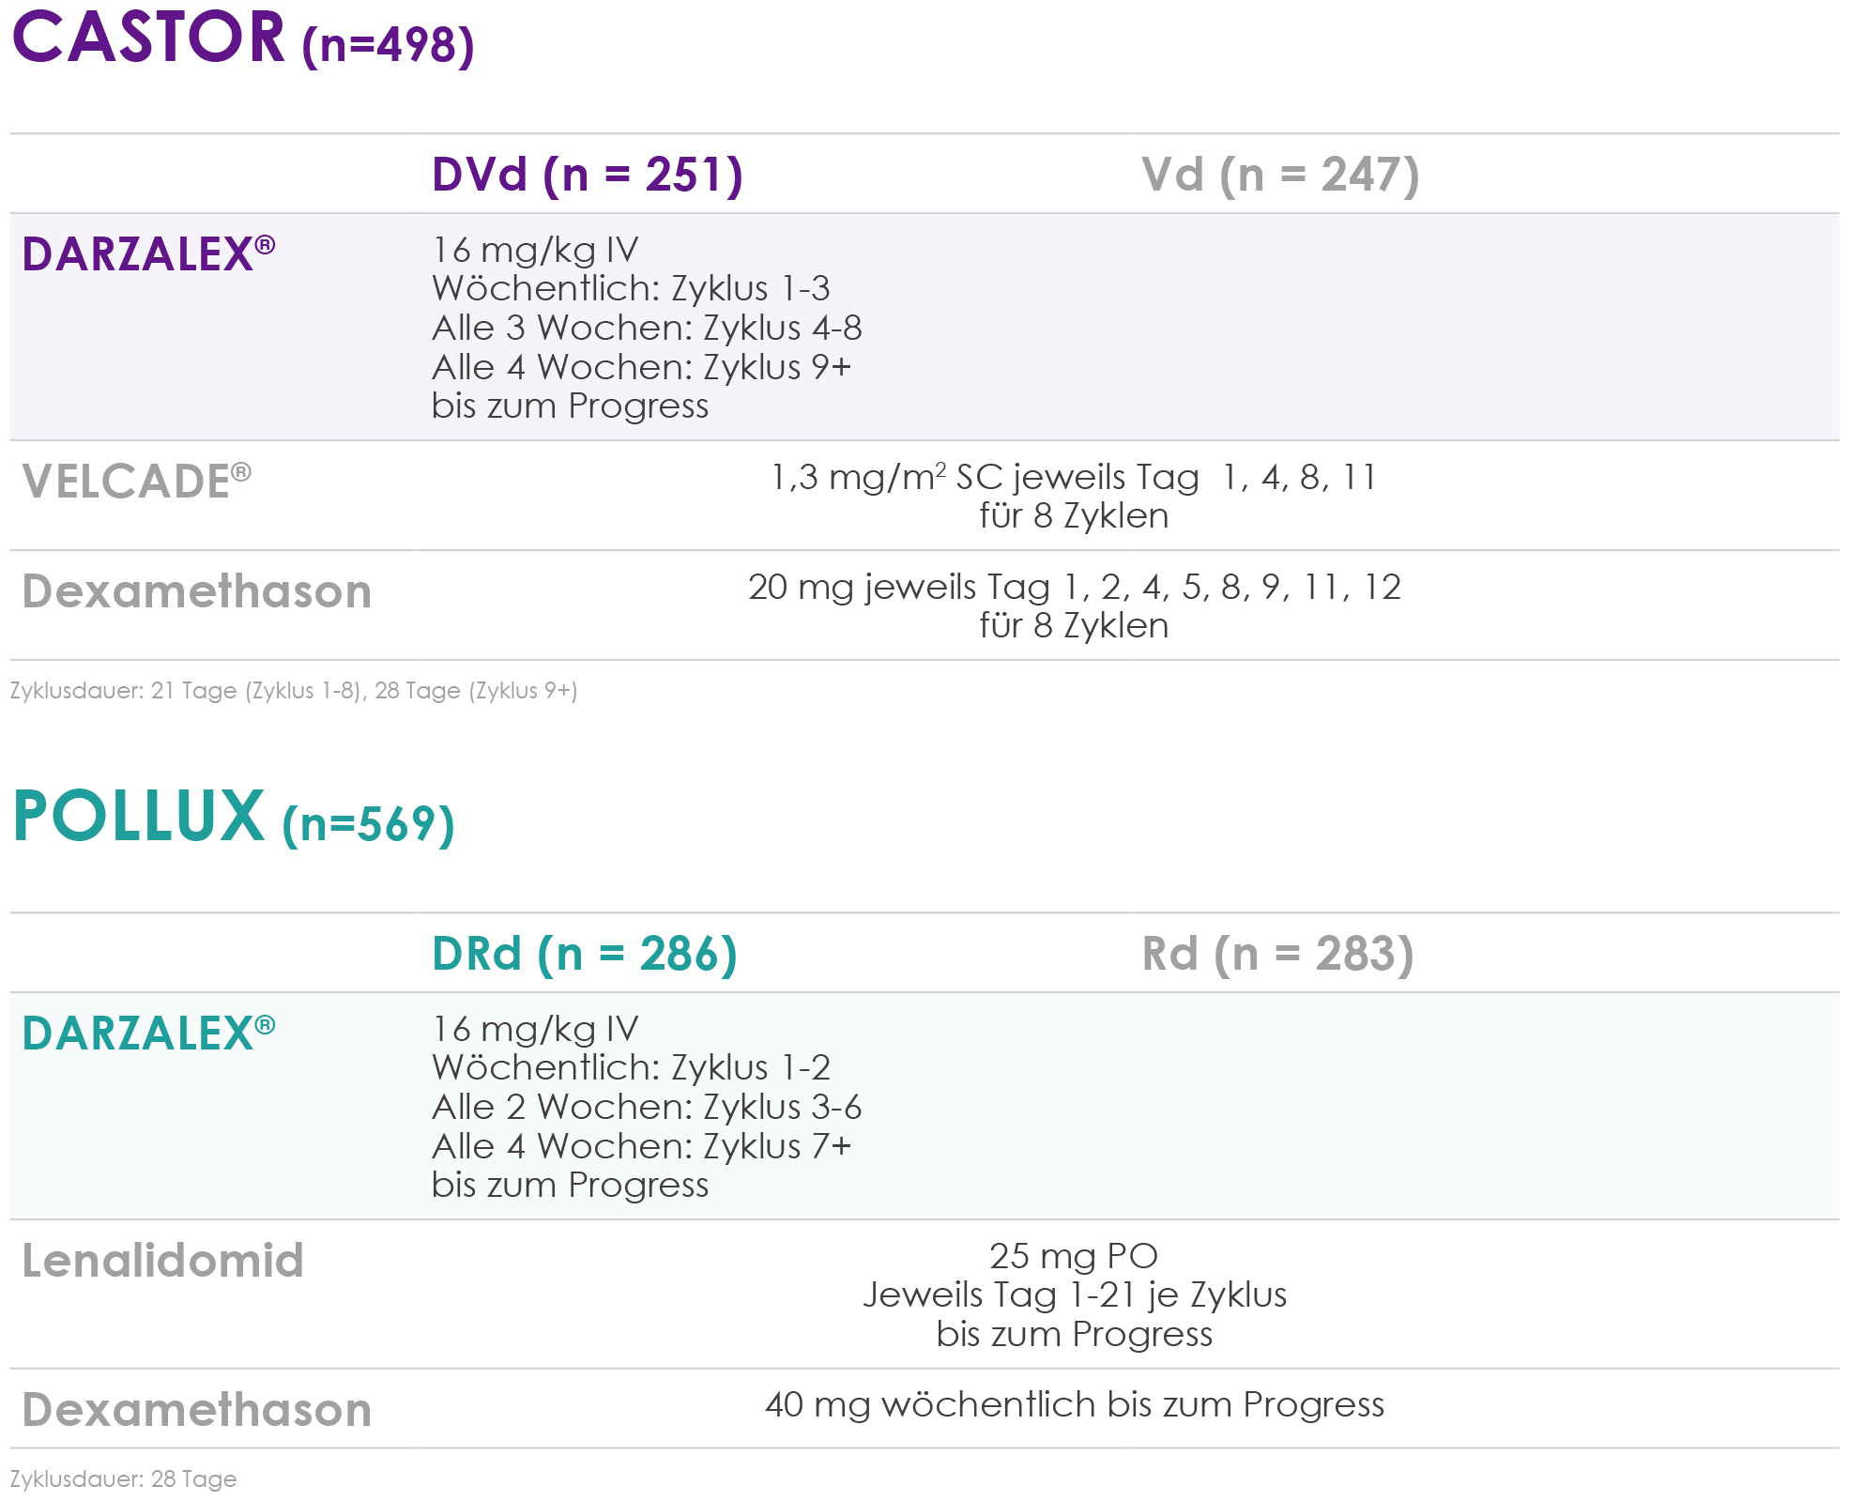
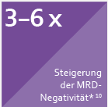
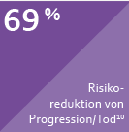
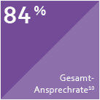
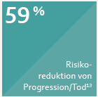
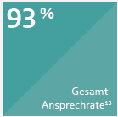
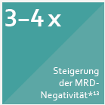
Studiendesign und Eckdaten DVd & DRd^{1,2}
Medianes Follow-up: 19,4 Monate³
Medianes Follow-up: 25,4 Monate⁴
1. Palumbo A. et al. Daratumumab, Bortezomib, and Dexamethasone for Multiple Myeloma. NEJM 2016; 375(8):754-766; 2. Dimopoulos MA. et al. Daratumumab, Lenalidomide, and Dexamethasone for Multiple Myeloma. NEJM 2016; 375(14):1319-1331; 3. Weisel K et al. Efficacy and Safety of Daratumumab, Bortezomib, and Dexamethasone (DVd) Versus Bortezomib and Dexamethasone (Vd) in Relapsed or Refractory Multiple Myeloma (RRMM): Updated Analysis of CASTOR. EHA 2017, Madrid. Oral Presentation (Abstract #S459); 4. Dimopoulos MA et al. Efficacy and Safety of Daratumumab, Lenalidomide, and Dexamethasone (DRd) Versus Rd Alone in Relapsed or Refractory Multiple Myeloma (RRMM): Updated Analysis of POLLUX, EHA 2017, Madrid. Poster #334
PHAT/DAT/0517/0012a

Slide 33
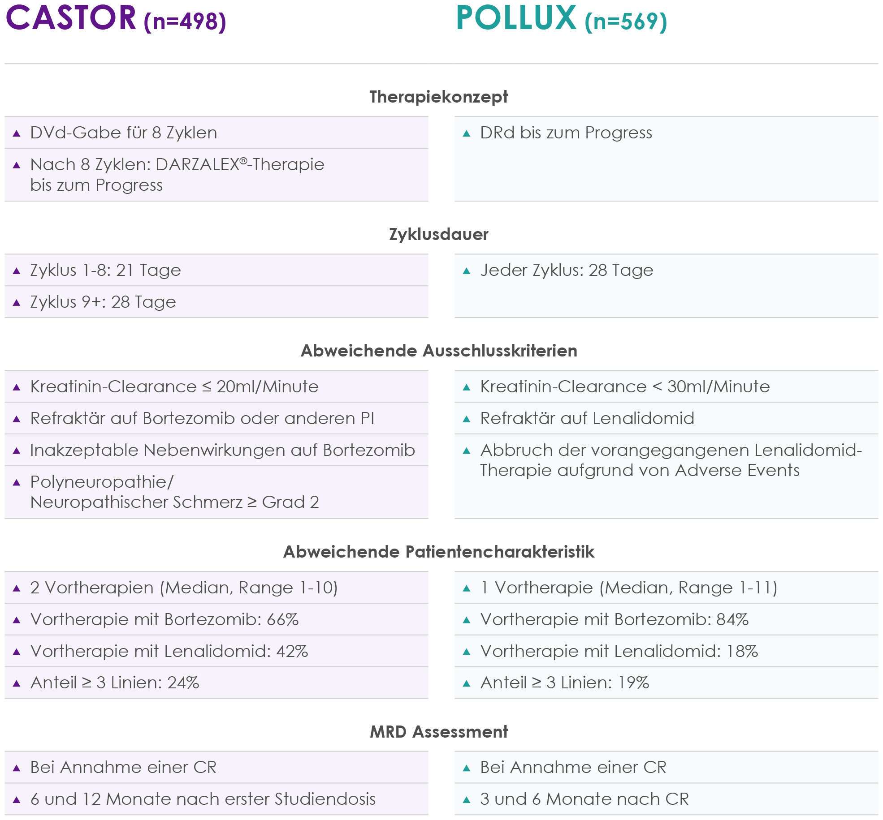
Wesentliche Unterschiede im Studiendesign^{1,2}
1. Palumbo A. et al. Daratumumab, Bortezomib, and Dexamethasone for Multiple Myeloma. NEJM 2016; 375(8):754-766; 2. Dimopoulos MA. et al. Daratumumab, Lenalidomide, and Dexamethasone for Multiple Myeloma. NEJM 2016; 375(14):1319-1331

Slide 34
Bahnbrechende Fortschritte
>58% Risikoreduktion von Progression und Tod^{1,2}
>2fache CR-Ansprechen^{1,2}
3-6fache Erhöhung hinsichtlich MRD-Negativität^{1,2}
# Durchbruch und Meilenstein in der Therapie des Multiplen Myeloms siehe Rajkumar S.V., Kyle R. A Progress in Myeloma – A Monoclonal Breakthrough. NEJM 2016; 375 (14):1390-1392
1. Weisel K et al. Efficacy and Safety of Daratumumab, Bortezomib, and Dexamethasone (DVd) Versus Bortezomib and Dexamethasone (Vd) in Relapsed or Refractory Multiple Myeloma (RRMM): Updated Analysis of CASTOR. EHA 2017, Madrid. Oral Presentation (Abstract #S459); 2. Dimopoulos MA et al. Efficacy and Safety of Daratumumab, Lenalidomide, and Dexamethasone (DRd) Versus Rd Alone in Relapsed or Refractory Multiple Myeloma (RRMM): Updated Analysis of POLLUX, EHA 2017, Madrid. Poster #334

Slide 35
Tiefste Hazard Ratios unter DARZALEX® Nach 1 Vortherapie beim Multiplen Myelom^{*,1-10}
Tiefste Hazard Ratios unter DARZALEX® Nach 1 Vortherapie beim Multiplen Myelom*^{,1-8}
D = DARZALEX® (Daratumumab)
d = Dexamethason
E = Empliciti® (Elotuzumab)
I = Ninlaro® (Ixazomib)
K = Kyprolis® (Carfilzomib)
M = Melphalan
P = Prednison
PLd = CAELYX® (peg. liposomales Doxorubicin)
Pano = Farydak® (Panobinostat)
Pom = IMNOVID® (Pomalidomid)
R = Revlimid® (Lenalidomid)
T = Thalidomid
V = VELCADE® (Bortezomib)
*Stand Juni 2017 – Kein Anspruch auf Vollständigkeit. HR-Raten von DVd und DRd beziehen sich auf die aktuellsten medianen Follow-ups, präsentiert am ASCO / EHA 2017, Chicago (CASTOR: 19,4 Monate, POLLUX: 25,4 Monate). Alle anderen HRs beziehen sich auf die Daten der jeweiligen Zulassungsstudien, angeführt in den Fachinformationen. Bitte beachten Sie die vollständigen Anwendungsgebiete der Arzneimittel in der jeweiligen Fachinformation.
1 Fachinformation Velcade 21.2.2017, 2 Fachinformation Darzalex 2.8.2017, 3 Fachinformation Revlimid (April 2017) unter: http://www.ema.europa.eu/ (aufgerufen am 23.5.2017), 4 Fachinformation Kyprolis (April 2017) unter: http://www.ema.europa.eu/ (aufgerufen am 23.5.2017), 5 Fachinformation Farydak (Nov 2016) unter: http://www.ema.europa.eu/ (aufgerufen am 23.5.2017), 6 Fachinformation Imnovid (Sep 2016) unter: http://www.ema.europa.eu/ (aufgerufen am 23.5.2017), 7 Fachinformation Empliciti (Dez 2016) unter: http://www.ema.europa.eu/ (aufgerufen am 23.5.2017), 8 Fachinformation Ninlaro (Dez 2016) unter: http://www.ema.europa.eu/ (aufgerufen am 23.5.2017), 9 Weisel K et al. Efficacy and Safety of Daratumumab, Bortezomib, and Dexamethasone (DVd) Versus Bortezomib and Dexamethasone (Vd) in Relapsed or Refractory Multiple Myeloma (RRMM): Updated Analysis of CASTOR. EHA 2017, Madrid. Oral Presentation (Abstract #S459); 10. Dimopoulos MA et al. Efficacy and Safety of Daratumumab, Lenalidomide, and Dexamethasone (DRd) Versus Rd Alone in Relapsed or Refractory Multiple Myeloma (RRMM): Updated Analysis of POLLUX, EHA 2017, Madrid. Poster #334

Slide 36
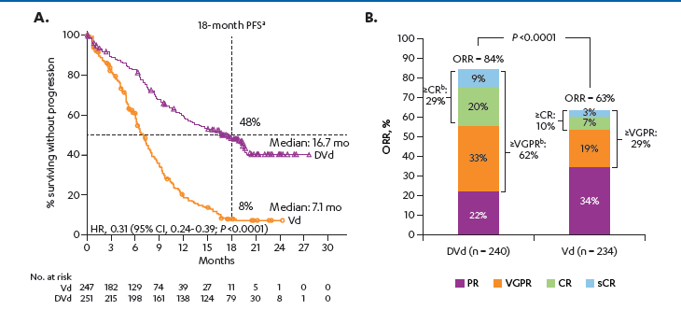
18-Monats-PFS DVd: 48% ohne Progression Anteil Patienten ohne Progression bei 48% unter DVd Vs. 8% unter Vd¹
69%ige Risikoreduktion
von Progression/Tod
1 Weisel K et al. Efficacy and Safety of Daratumumab, Bortezomib, and Dexamethasone (DVd) Versus Bortezomib and Dexamethasone (Vd) in Relapsed or Refractory Multiple Myeloma (RRMM): Updated Analysis of CASTOR. EHA 2017, Madrid. Oral Presentation (Abstract #S459)

Slide 37
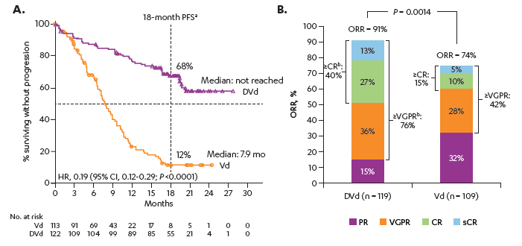
18-Monats-PFS DVd NACH 1 VORTHERAPIE verbesserte PFS-Daten gegenüber der Gesamtpopulation¹
Nach 1 Vortherapie
81%ig Risikoreduktion
von Progression/Tod
Gesamtpopulation
1 Weisel K et al. Efficacy and Safety of Daratumumab, Bortezomib, and Dexamethasone (DVd) Versus Bortezomib and Dexamethasone (Vd) in Relapsed or Refractory Multiple Myeloma (RRMM): Updated Analysis of CASTOR. EHA 2017, Madrid. Oral Presentation (Abstract #S459)

Slide 38
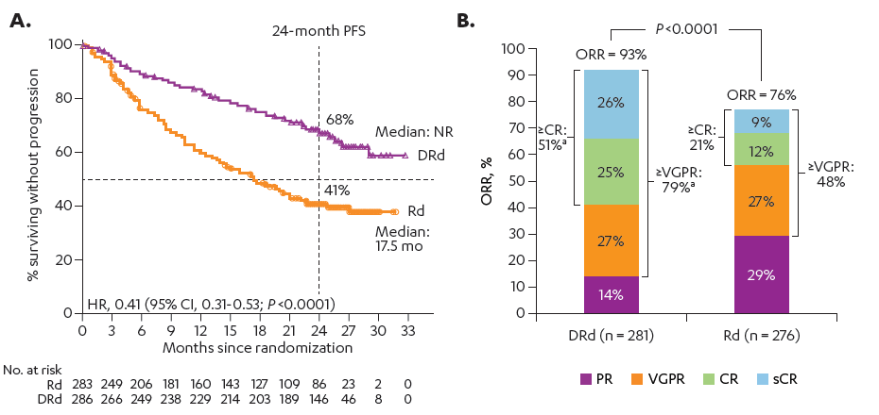
24-Monats-PFS DRd: 68% ohne Progression Anteil Patienten ohne Progression bei 68% unter DRd Vs. 41% unter Rd¹
59%ige Risikoreduktion
von Progression/Tod
1 . Dimopoulos MA et al. Efficacy and Safety of Daratumumab, Lenalidomide, and Dexamethasone (DRd) Versus Rd Alone in Relapsed or Refractory Multiple Myeloma (RRMM): Updated Analysis of POLLUX, EHA 2017, Madrid. Poster #334

Slide 39
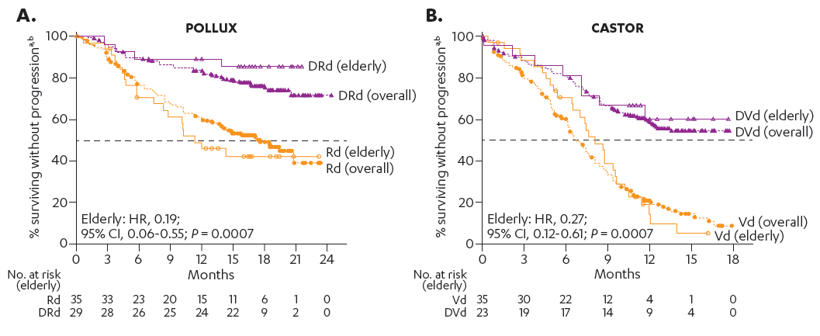
Vergleichbare Effektivität auch bei Älteren auch Patienten ≥75 Jahre profitieren von DVd und DRd¹
81%ige Risikoreduktion
von Progression/Tod
73%ige Risikoreduktion
von Progression/Tod
Medianes Follow-up: 17,3 Monate
Medianes Follow-up: 13 Monate
1 . Mateos MV et al. Daratumumab-based Combination Regimens in Elderly (≥75 Years) Patients With Relapsed or Refractory Multiple Myeloma (RRMM): Subgroup Analysis of the Phase 3 CASTOR and POLLUX Studies. EHA 2017, Madrid, Abstract #P335

Slide 40
Bahnbrechende Fortschritte
>58% Risikoreduktion von Progression und Tod^{1,2}
>2fache CR-Ansprechen^{1,2}
3-6fache Erhöhung hinsichtlich MRD-Negativität^{1,2}
# Durchbruch und Meilenstein in der Therapie des Multiplen Myeloms siehe Rajkumar S.V., Kyle R. A Progress in Myeloma – A Monoclonal Breakthrough. NEJM 2016; 375 (14):1390-1392
1. Weisel K et al. Efficacy and Safety of Daratumumab, Bortezomib, and Dexamethasone (DVd) Versus Bortezomib and Dexamethasone (Vd) in Relapsed or Refractory Multiple Myeloma (RRMM): Updated Analysis of CASTOR. EHA 2017, Madrid. Oral Presentation (Abstract #S459); 2. Dimopoulos MA et al. Efficacy and Safety of Daratumumab, Lenalidomide, and Dexamethasone (DRd) Versus Rd Alone in Relapsed or Refractory Multiple Myeloma (RRMM): Updated Analysis of POLLUX, EHA 2017, Madrid. Poster #334

Slide 41
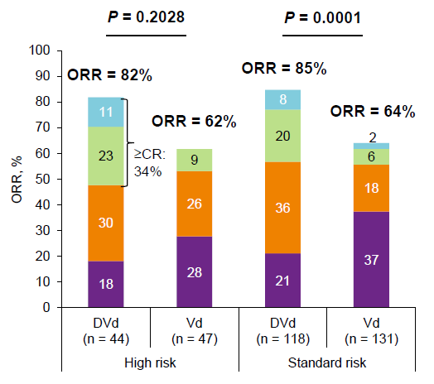
DVd: Bis zu 91% Gesamtansprechrate ≥ 34% Komplettremissionen Auch bei High risk ZYTOGENETIK^{1,2}
Gesamtpopulation¹:
84% ORR, ≥ CR 29%
Nach 1 Vortherapie¹:
91% ORR, ≥ CR 40%
High Risk²:
82% ORR, ≥ CR 34%
14% der High Risk Patienten erreichten unter DVd eine MRD Negativität 10⁻⁵
(0% unter Vd)²
1. Weisel K et al. Efficacy and Safety of Daratumumab, Bortezomib, and Dexamethasone (DVd) Versus Bortezomib and Dexamethasone (Vd) in Relapsed or Refractory Multiple Myeloma (RRMM): Updated Analysis of CASTOR. EHA 2017, Madrid. Oral Presentation (Abstract #S459); 2 San-Miguel J et al. EFFICACY BY CYTOGENETIC RISK STATUS FOR DARATUMUMAB IN COMBINATION WITH LENALIDOMIDE AND DEXAMETHASONE OR BORTEZOMIB AND DEXAMETHASONE IN RELAPSED OR REFRACTORY MULTIPLE MYELOMA. EHA 2017, Madrid. Oral Presentation (Abstract #S101)

Slide 42
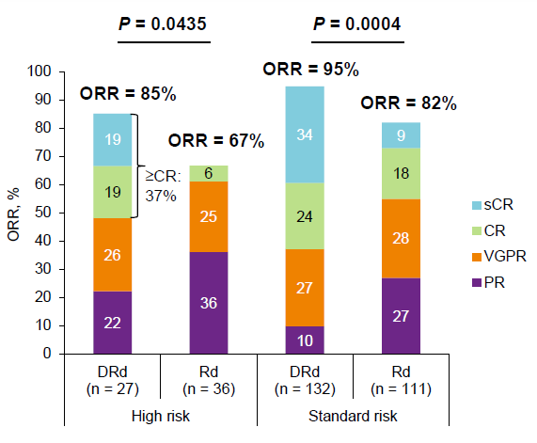
DRd: Bis zu 93% Gesamtansprechrate ≥ 37% Komplettremissionen Auch bei High risk ZYTOGENETIK^{1,2}
Gesamtpopulation¹:
93% ORR, ≥ CR 51%
High Risk²:
85% ORR, ≥ CR 37%
21% der High Risk Patienten erreichten unter DRd eine MRD Negativität 10⁻⁵
(0% unter Rd)²
1 Dimopoulos MA et al. Efficacy and Safety of Daratumumab, Lenalidomide, and Dexamethasone (DRd) Versus Rd Alone in Relapsed or Refractory Multiple Myeloma (RRMM): Updated Analysis of POLLUX, EHA 2017, Madrid. Poster #334); 2 San-Miguel J et al. EFFICACY BY CYTOGENETIC RISK STATUS FOR DARATUMUMAB IN COMBINATION WITH LENALIDOMIDE AND DEXAMETHASONE OR BORTEZOMIB AND DEXAMETHASONE IN RELAPSED OR REFRACTORY MULTIPLE MYELOMA. EHA 2017, Madrid. Oral Presentation (Abstract #S101)
PHAT/DAT/0517/0012a

Slide 43
Bahnbrechende Fortschritte
>58% Risikoreduktion von Progression und Tod^{1,2}
>2fache CR-Ansprechen^{1,2}
3-6fache Erhöhung hinsichtlich MRD-Negativität^{1,2}
# Durchbruch und Meilenstein in der Therapie des Multiplen Myeloms siehe Rajkumar S.V., Kyle R. A Progress in Myeloma – A Monoclonal Breakthrough. NEJM 2016; 375 (14):1390-1392
1. Weisel K et al. Efficacy and Safety of Daratumumab, Bortezomib, and Dexamethasone (DVd) Versus Bortezomib and Dexamethasone (Vd) in Relapsed or Refractory Multiple Myeloma (RRMM): Updated Analysis of CASTOR. EHA 2017, Madrid. Oral Presentation (Abstract #S459); 2. Dimopoulos MA et al. Efficacy and Safety of Daratumumab, Lenalidomide, and Dexamethasone (DRd) Versus Rd Alone in Relapsed or Refractory Multiple Myeloma (RRMM): Updated Analysis of POLLUX, EHA 2017, Madrid. Poster #334

Slide 44
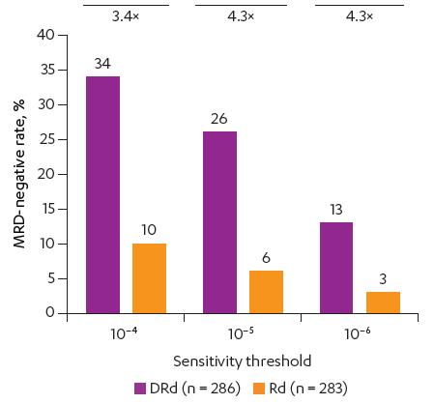
MRD-Raten bei DVd und DRd 3-6fach erhöht^{1,2}
CASTOR¹
GESAMTPOPULATION
POLLUX²
GESAMTPOPULATION
Nach 1 Vortherapie
1. 1. Weisel K et al. Efficacy and Safety of Daratumumab, Bortezomib, and Dexamethasone (DVd) Versus Bortezomib and Dexamethasone (Vd) in Relapsed or Refractory Multiple Myeloma (RRMM): Updated Analysis of CASTOR. EHA 2017, Madrid. Oral Presentation (Abstract #S459); 2. Dimopoulos MA et al. Efficacy and Safety of Daratumumab, Lenalidomide, and Dexamethasone (DRd) Versus Rd Alone in Relapsed or Refractory Multiple Myeloma (RRMM): Updated Analysis of POLLUX, EHA 2017, Madrid. Poster #334

Slide 45
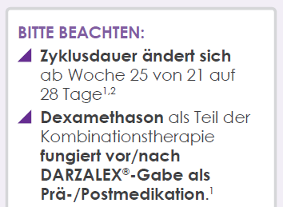
Dosierungsschema DVd^{1,2}
1. DARZALEX Fachinformation 28.04.2017; 2. Palumbo A. et al. Daratumumab, Bortezomib, and Dexamethasone for Multiple Myeloma. NEJM 2016; 375(8):754-766

Slide 46
Prä- und postmedikation bei DVd^{1,2}
Vor JEDER Infusion
Abhängig vom VORTAG
oder BMI <18,5
1. DARZALEX Fachinformation 28.04.2017; 2. Palumbo A. et al. Daratumumab, Bortezomib, and Dexamethasone for Multiple Myeloma. NEJM 2016; 375(8):754-766

Slide 47
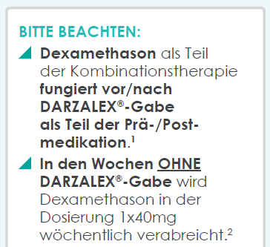
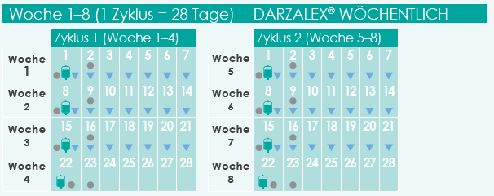
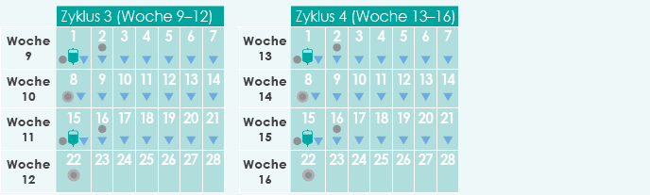
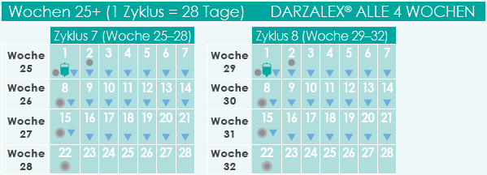
Dosierungsschema DRd^{1,2}
1. DARZALEX Fachinformation 28.04.2017; 2. Dimopoulos MA. et al. Daratumumab, Lenalidomide, and Dexamethasone for Multiple Myeloma. NEJM 2016; 375(14):1319-1331

Slide 48
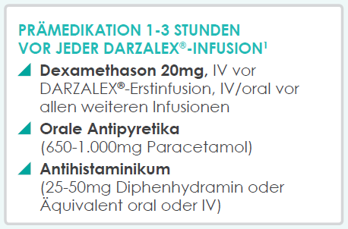
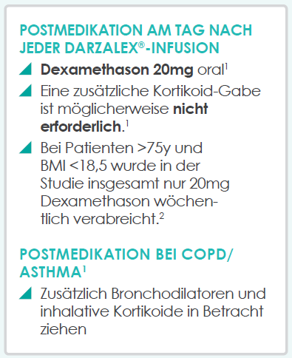
Prä- und postmedikation bei DRd^{1,2}
Vor JEDER Infusion
Nach JEDER
Infusion
oder
1. DARZALEX Fachinformation 28.04.2017; 2. Dimopoulos MA. et al. Daratumumab, Lenalidomide, and Dexamethasone for Multiple Myeloma. NEJM 2016; 375(14):1319-1331

Slide 49
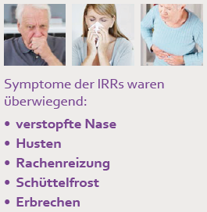
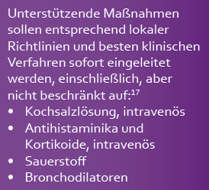
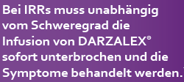
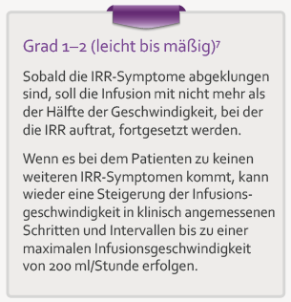
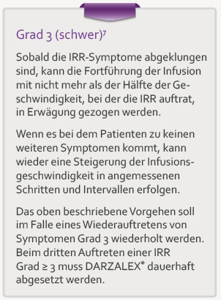
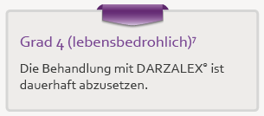
Symptome und Vorgehen bei IRRs Mediane Zeit bis zum Auftreten: 1,4 Stunden (Bereich 0,02-72,8 Stunden)¹
Hauptsächlich Grad 1-2
1. DARZALEX® Fachinformation 28.04.2017

Slide 50
Phase 1b study of Dara-KRd in newly-diagnosed MM
Dosing Schedule (28-d cycles)
Daratumumab:
Split dose: 8 mg/kg Days 1-2 of Cycle 1
16 mg/kg QW on Cycles 1-2, Q2W on Cycles 3-6, and Q4W thereafter
Carfilzomib:
20 mg/m² C1D1
Escalated to 70 mg/m² C1D8+; weekly (Days 1, 8, 15)
Lenalidomide:
25 mg; Days 1-21 of each cycle
Dexamethasone: 40 mg/weekª
(N = 22)
Pre- and post-infusion medications:
Dexamethasone 20 mg^{b}; Diphenhydramine 25-50 mg; paracetamol 650-1,000 mg; montelukast 10 mg^{c}
NDMM, transplant eligible and non-eligible; no clinically significant cardiac disease; echo required at screening
Treatment duration: ≤13 cycles or until elective discontinuation for ASCT
Primary endpoint: safety, tolerability
Secondary endpoints: ORR, duration of response, time to response, IRR
Exploratory endpoint: PFS
ª20 mg if >75 y. ^{b}On daratumumab dosing days, dexamethasone 20 mg IV was administered as pre-medication on infusion day and 20 mg PO the day after infusion; for DARA, split first dose dexamethasone 20 mg IV was administered as a pre-medication on C1D1 and C1D2; on C1D3, administration of low-dose methylprednisolone (≤20 mg PO) was optional. ^{c}Required before first daratumumab dose, optional for subsequent doses.
Jakubowiak A, et al. Presented at ASCO 2017 (Abstract 8000), oral presentation.

Slide 51
Phase 1b study of Dara-KRd in newly-diagnosed MM: induction
*5 patients who proceeded to ASCT before C8 and 1 patient who discontinued due to PD at C7 were excluded.
Depth of response improved with duration of treatment
PR, partial response; CR, complete response; ªResponse-evaluable population. ^{b}Response rate (≥PR) evaluated by IMWG criteria; M-protein measurements by central lab assessment.
Jakubowiak A, et al. Presented at ASCO 2017 (Abstract 8000), oral presentation.

Slide 52
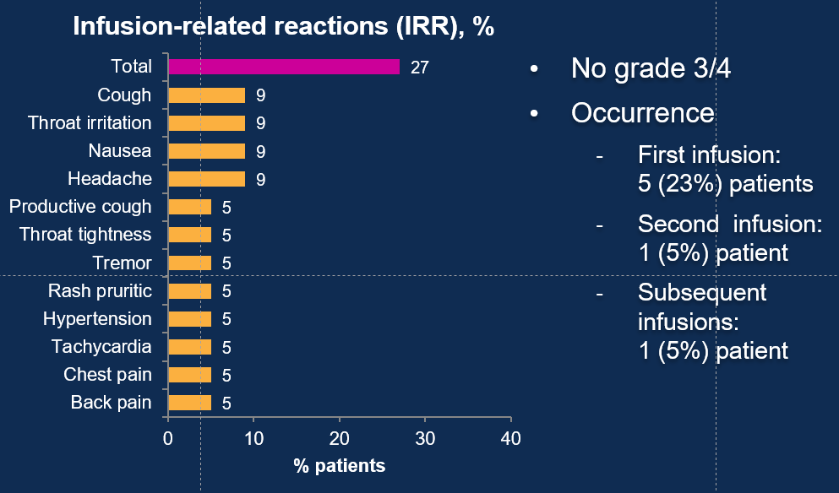
Phase 1b study: Dara-KRd in NDMM infusion times and reactions (N = 22)
Infusion Times
Infusion | Median (range) infusion time, h
First C1D1 C1D2 | 4.15 (4.0-6.0) 4.15 (3.9-6.0)
Second | 4.18 (3.6-7.1)
Subsequent | 3.38 (1.4-6.1)
Lower rates of IRRs observed with split first dosing
Jakubowiak A, et al. Presented at ASCO 2017 (Abstract 8000), oral presentation.

Slide 53
Phase 2a study of Elo-RVd in newly-diagnosed autotransplant-eligible MM patients
Risk-Adapted Maintenance‡
(28-day cycles)
Immediate
ASCT
N=40
Elotuzumab* +
RVd Induction†
(four 21-day cycles)
Follow-up every
3 mos
until PD
Elotuzumab* +
RVd Induction†
4 cycles, then
Risk-Adapted Maintenance‡
(28-day cycles)
Deferred
ASCT
*ELO: 10 mg/kg IV on Day 1, 8, 15 for cycles 1, 2 and Day 1, 11 thereafter. †Len: 25 mg PO Days 1-14; Bort: 1.3 mg/m² SC on Day 1, 4, 8, 11; Dex: 20 mg PO Day 2, 4, 5. 9, 11, 12, and 28 mg PO before ELO infusion; 8 mg IV Day 1, 8, 15 before ELO infusion.
‡High risk (ISS stage III and/or high-risk cytogenetics): ELO + RVd; standard risk (ISS stage I/II w/o high-risk cytogenetics): ELO + Len/Dex.
Primary objective: response rate after 4 cycles of ELO + RVd
Secondary objectives: proportion of patients with SC mobilization after 4 cycles ELO + RVd; proportion with dose modification within 4 cycles ELO + RVd; safety; clinical activity
Laubach J, et al. Presented at ASCO 2017 (Abstract 8002) oral presentation.

Slide 54
Elo-RVd in NDMM: induction
Response After 4 Cycles, % | All Patients (N = 40) | Patients With ASCT (n = 20) | Patients Deferring ASCT (n = 20)
ORR | 82 | 95 | 70
PR | 28 | 25 | 30
VGPR | 40 | 45 | 35
CR | 15 | 25 | 5
Laubach J, et al. Presented at ASCO 2017 (Abstract 8002) oral presentation.

Slide 55
Elo-RVd in NDMM: grade ≥3 adverse events
Nonhematologic AE, % | Patients (N = 40)
 | Grade 3 | Grade 4 | Grade 5
Hypophosphatemia | 12 | 0 | 0
Back pain | 10 | 0 | 0
Fatigue | 10 | 0 | 0
Lung infection | 10 | 0 | 0
Hypertension | 8 | 0 | 0
Syncope | 8 | 0 | 0
Increased ALT | 5 | 0 | 0
Fever | 5 | 0 | 0
Hyperglycemia | 2 | 2 | 0
Hypotension | 5 | 0 | 0
Rash | 5 | 0 | 0
Sepsis | 0 | 2 | 2
Cardiac arrest | 0 | 2 | 0
Respiratory failure | 0 | 2 | 0
6/40 patients (15%) discontinued treatment within 4 cycles
50% of patients had infection, including grade ≥3 lung infection (10%); sepsis grade 4 (2%) and sepsis grade 5 (2%)
2 patients died (sepsis, 1 on study, 1 > 30 days after discontinuation of treatment)
AE, adverse event; ALT, alanine aminotransferase; ASCT, autologous stem cell transplantation; MM, multiple myeloma; ND, newly diagnosed; RVd, lenalidomide/bortezomib/dexamethasone.
Laubach J, et al. Presented at ASCO 2017 (Abstract 8002) oral presentation.

Slide 56
Zusammenfassung
Konsolidierungstherapie
sollte zunehmend mehr als Standard in Betracht gezogen werden
vor allem bei < CR Patienten nach autologer SZT (VTD, VRD, KRD)
Erhaltungstherapie
sollte individualisiert angewendet werden
sollte bei < nCR oder bei ungünstiger Risikosituation in Erwägung gezogen werden.
Zukünftige Erhaltungstherapien
Kombination von IMiDs mit Ixazomib oder Antikörpern bei HR MM?
PD-1 Blockade mit DC/Myelom Vakzine Therapie nach ASZT
Chimärische Antigen-Rezeptor (CAR) T-Zell Therapie nach ASZT

Slide 57
Danke für die Aufmerksamkeit

